Slide 1
SER 502 Project DevLingo Team - 20
Manmeet Singh
Jay Sachin Chiddarwar
Ajinkya Abhinay Pise
Debesh K Pradhan
Rahul Balulmath

Slide 2
Introduction
Language Name – DevLingo
Systems Used – MacOS
Tools Used –
ANTLR
IntelliJ Idea
Extensions used –
.dvlg (Input Program)
.dvac(Intermediate Code)

Slide 3
Basic Features
Boolean values: “Boolean” support Boolean operators: The language supports Boolean operators such as “and”, “or”, and “not” for working with Boolean values.
Numeric operators: The language supports “int” as the numeric operator. It supports all the basic arithmetic computations such as addition, multiplication, subtraction, and division.
String value assignments: The language supports string value assignments as “string”. Basic operations such as printing and assigning to an identifier are implemented.
Assignment operator: The language includes an assignment operator which helps to assign a value to an identifier.
Conditional statements: Traditional if-else statements and ternary operators have been included in the language for conditional statements.
Iterative loops: The language supports iterative loops such as for loop, while loop, and for-range loops for executing a block of code repeatedly.
Print statement: The language includes a print statement “printf” for printing out the values of identifiers. This supports all the data types covered in the language.

Slide 4
Grammar

Slide 5
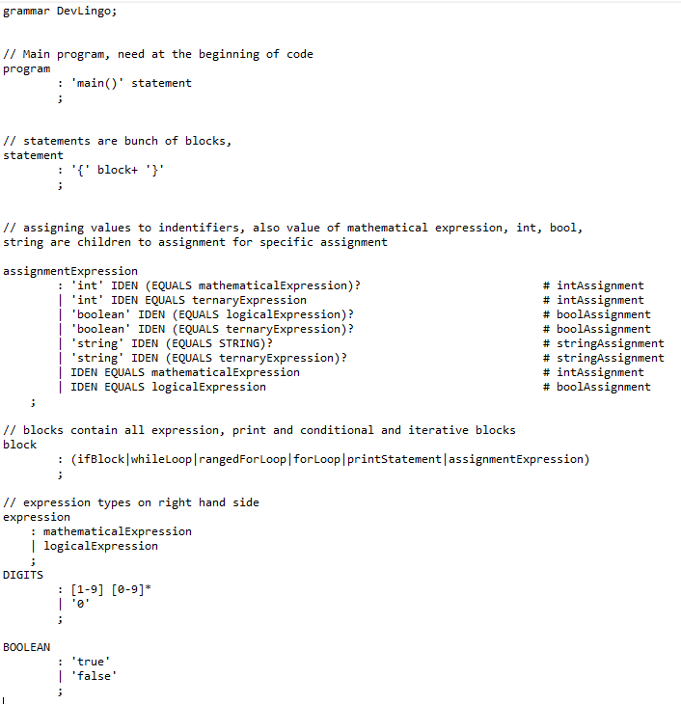
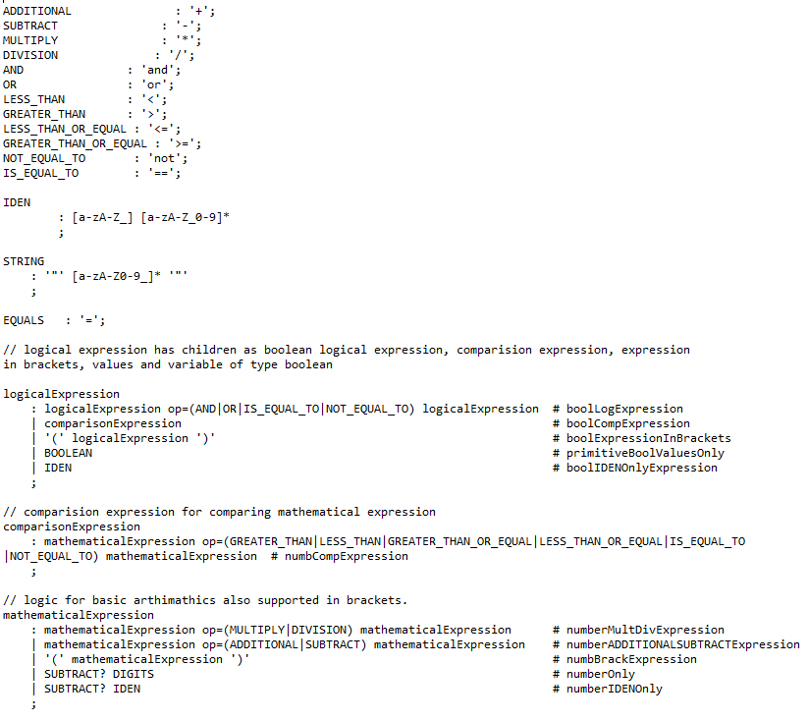
Grammar rules are present in .g4 file
Notes:
The program rule defines the main program structure. It specifies that the program must start with a main() function call followed by a statement.The statement rule defines a block of code. It specifies that a statement is a sequence of one or more blocks enclosed in curly braces.
The assignmentExpression rule defines how values are assigned to identifiers in the language. It supports assigning integer, boolean, and string values to identifiers. It also supports assigning the result of a mathematical or logical expression to an identifier.The block rule defines the structure of a block. It specifies that a block can be an ifBlock, whileLoop, rangedForLoop, forLoop, printStatement, or assignmentExpression.The expression rule defines the two types of expressions supported in the language: mathematical and logical expressions.
The DIGITS rule defines how to match integers in the language. It matches any sequence of digits, including zero.
The BOOLEAN rule defines how to match boolean values in the language. It matches the strings "true" and "false".
The ADDITIONAL, SUBTRACT, MULTIPLY, DIVISION, AND, OR, LESS_THAN, GREATER_THAN, LESS_THAN_OR_EQUAL, GREATER_THAN_OR_EQUAL, NOT_EQUAL_TO, and IS_EQUAL_TO rules define the various operators supported in the language.
The IDEN rule defines how to match identifiers in the language. It matches any sequence of alphanumeric characters starting with a letter.
The STRING rule defines how to match string literals in the language. It matches any sequence of alphanumeric characters surrounded by double quotes.
The EQUALS rule defines how to match the assignment operator in the language.
The logicalExpression rule defines the structure of logical expressions in the language. It can be a boolean logical expression, a comparison expression, a boolean value or variable, or an expression in brackets.
The comparisonExpression rule defines how to compare two mathematical expressions using the comparison operators supported in the language.
The mathematicalExpression rule defines the structure of mathematical expressions in the language. It supports addition, subtraction, multiplication, and division operations on integers. It also supports using variables and values in the expressions.

Slide 6
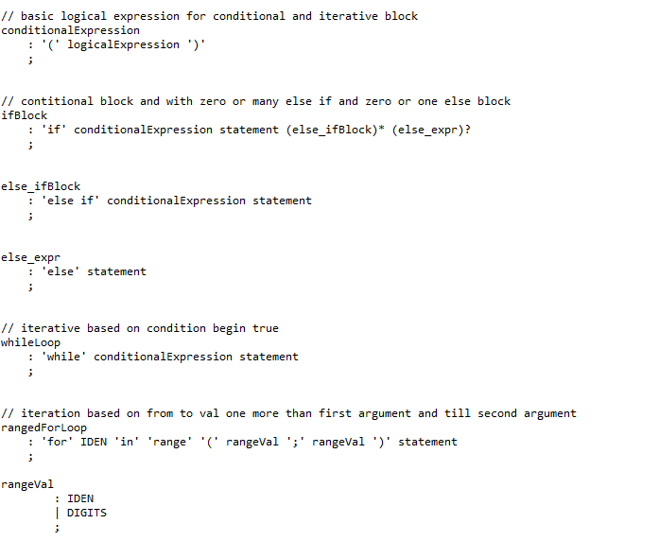
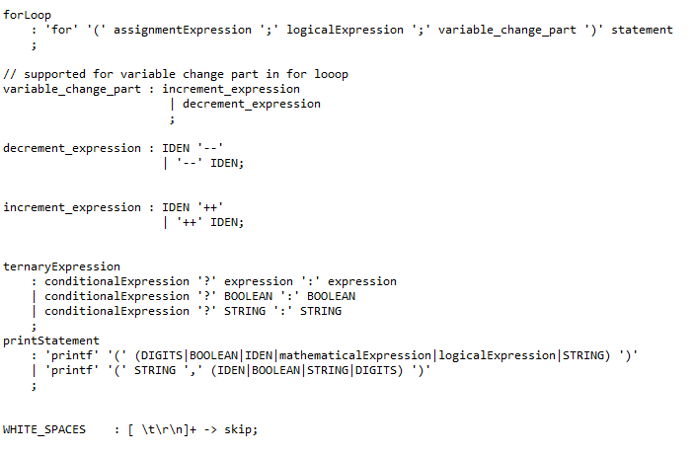

Slide 7
Program Flow

Slide 8
Flow of Program
Source
Code
Lexical
Analyzer
Tokens
Parser
Parse
Tree
Compiler
Program
Output
Runtime
Intermediate
Code

Slide 9
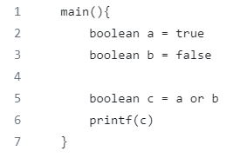
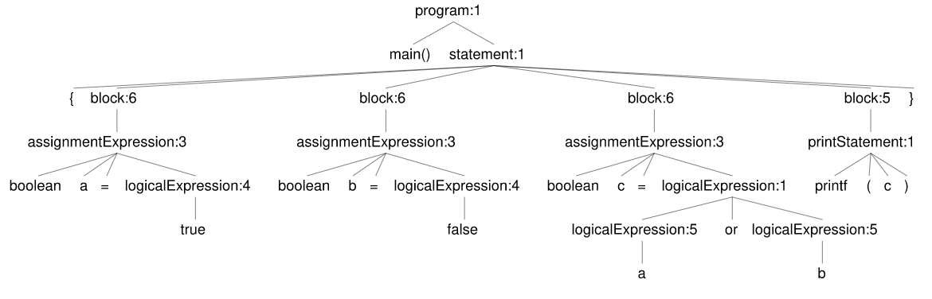
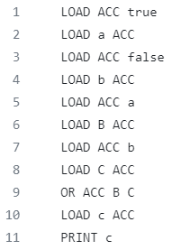
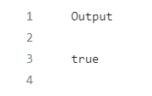
Flow of a Sample Program
Parse Tree
Source Code
Output
Intermediate code

Slide 10
Sample Runs

Slide 11
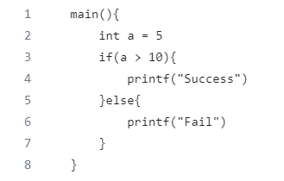
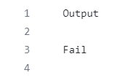
Sample Run – 1
Code
Output

Slide 12
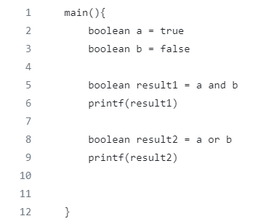
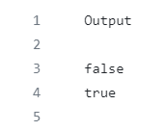
Sample Run - 2
Code
Output

Slide 13
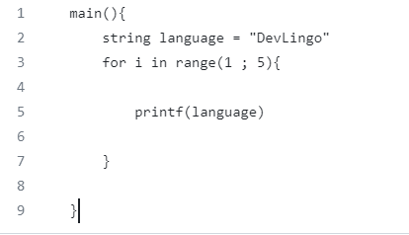
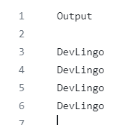
Sample Run - 3
Code
Output

Slide 14
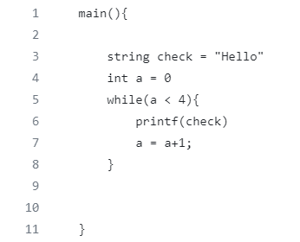
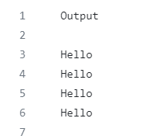
Sample Run - 4
Code
Output

Slide 15
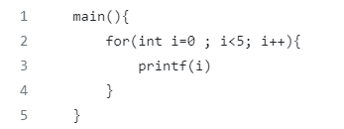
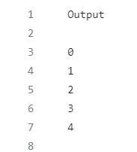
Sample Run - 5
Code
Output

Slide 16
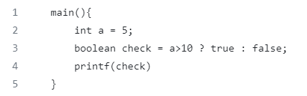

Sample Run - 6
Code
Output

Slide 17
Future Work
We can consider introducing new language structures or syntax to boost developer productivity and make the language more expressive. For example, we may include lambdas, functional programming structures, and enhanced concurrency support.
Improve performance: Improving language performance is always a worthwhile subject of study. We may investigate ways to improve the language quicker, either by enhancing the language runtime implementation or by making the language itself more efficient.
Extend platform support: While Java is extensively used, it may not be as well supported in other regions. Consider adding support for new platforms or settings, such as mobile or web development, to your language.
Improve tooling: Creating effective tools and IDEs may significantly increase developer productivity. Consider creating new tools or improving current ones to improve code completion, debugging, profiling, and other features.
Building a strong developer community around your language can assist assure its continued growth and development. Consider strategies to increase acceptance, produce developer documentation and tools, and assist individuals who wish to contribute to the project.

Slide 18
Thank You

